Slide 1
COMPUTER ORGANIZATION AND ARCHITECTURE (COA)
EET 2211
4TH SEMESTER – CSE & CSIT
OVERVIEW OF 8086 MICROPROCESSOR

Slide 2
EVALUATION SCHEME
INTERNAL COMPONENT | MARKS | EXTERNAL COMPONENT | MARKS
Mid-semester examination | 15 | End-semester examination | 45
Assignments | 10 | External project | 15
Quiz / Viva | 10
Attendance | 05
Total | 40 |  | 60

Slide 3
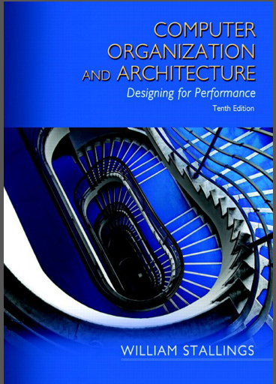
TEXT BOOKS
Computer Organization and Architecture by William Stallings, Pearson publication, 10TH Edition.

Slide 4
What is Computer Architecture?
It refers to those attributes of the system that are visible to the software programmer and have a direct impact on the logical execution of a program.
It basically defines the system in an abstract manner.
It deals with the concepts that the programmer deals with directly.
Includes logical units like instruction set, different types of addressing modes.

Slide 5
What is Computer Architecture?
Examples of architectural attributes include :
Instruction set
number of bits used for data representation
I/O mechanisms
addressing techniques

Slide 6
What is Computer Architecture?
3 main categories are considered while considering design of architecture:
System Design(contains hardware components that are used for building the system),
Instruction Set Architecture(includes all the instructions provided to the computer system) and
Micro Architecture( give minute detail about storage element)

Slide 7
What is Computer Organization?
It refers to the operational/functional unit and the interconnection between them that achieve the architectural specifications.
It tells us about different functional blocks of the system.
It is basically the realization of architecture and deals with functional structure and various structural relationships.

Slide 8
What is Computer Organization?
Organizational attributes include
Control signals
interfaces between the computer and peripherals
memory technology

Slide 9
What is Computer Organization?
It includes physical connection component like circuits with adder subtractors.
Single Accumulator Organization, General Register organization, Stack Organization are the 3 types of CPU organization.

Slide 10
Differences between Computer Architecture And Computer Organization
COMPUTER ORGANIZATION | COMPUTER ARCHITECTURE
1. Computer organization is concerned with the way hardware component are connected together to form a computer system. | 1.Computer Architecture is concerned with the structure and behaviour of the computer system as seen by the user.
2. While designing a computer system, an organisation is decided after the architecture. | 2. While designing computer system, architecture is decided first.
3. It involve physical units such as circuit design, adders,signals,peripherals etc. | 3. It involves logical components such as Instruction Set, Addressing Modes etc.
4. It describes how computer system works. | 4. It describes how computer system designed.

Slide 11
Differences between Computer Architecture And Computer Organization
5. It deals with the components of a computer and the interconnection of components. | 5. It acts as a interface between hardware and software.
6. Computer Organization deals with low-level design issues. | 6. Computer architecture deals with high-level design issues.
7. Computer Organization defines the physical aspects of the computer system. | 7.Computer architecture defines the logical aspects of computer system.
8. It deals with the organizational structure of the computer and the various structural relationship. | 8. It deals with the functional behavior of the computer system.
9.It is also called micro architecture. | 9. It is also called as instruction set architecture.
10. It is transparent from the software programmer. | 10. It is visible to the software programmer.
11. How to do?(implementation of the architecture) | 11.What to do? (Instruction Set)

Slide 12
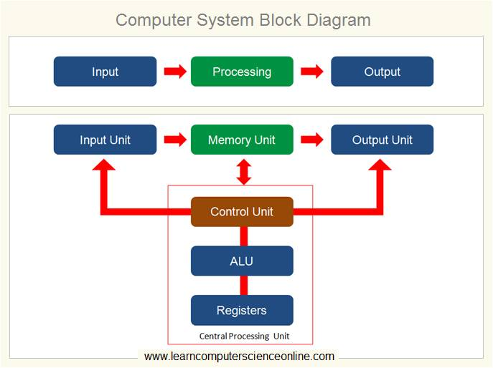

Slide 13
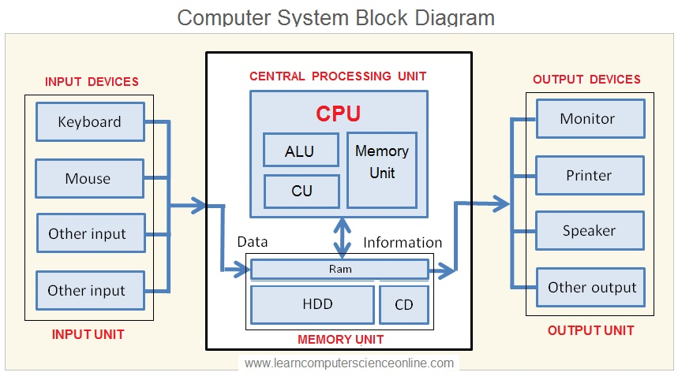

Slide 14
OVERVIEW OF 8086 MICROPROCESSOR
TOPICS TO BE COVERED
Register Organization of 8086
Architecture
Addressing modes of 8086
Instruction set of 8086

Slide 15
LEARNING OBJECTIVES
After studying this chapter, you should be able to:
Present an overview of the evolution of computer technology from early digital computers to the latest microprocessors.
Present an overview of the evolution of the x86 architecture.

Slide 16
MICROPROCESSOR
Microprocessor is a miniature electronic device that contains the arithmetic, logic, and control circuitry necessary to perform the functions of a digital computer’s central processing unit.
It can interpret and execute program instructions as well as handle arithmetic operations.
The first microprocessor was the Intel 4004, which was introduced in 1971.
The production of inexpensive microprocessors enabled computer engineers to develop microcomputers.

Slide 17
MICROPROCESSOR
These computer systems are small but have enough computing power to perform many business, industrial, and scientific tasks.
The microprocessor also permitted the development of so-called intelligent terminals, such as automatic teller machines and point-of-sale terminals employed in retail stores.
The microprocessor also provides automatic control of industrial robots, surveying instruments, and various kinds of hospital equipment.
It has brought about the computerization of a wide array of consumer products, including programmable microwave ovens, television sets, and electronic games. In addition, some automobiles feature microprocessor-controlled ignition and fuel systems designed to improve performance and fuel economy.

Slide 18
HISTORICAL BACKGROUND
The Mechanical Age
The Electrical Age
1946 | The first general purpose programmable electronic computer system- ENIAC (Electronics Numerical Integrator and Calculator) was developed. 17,000 vacuum tubes 500 miles of wires Weighted over 30 tons Performed about 1,00,000 operations per second Programmed by rewiring its circuits
1948 | Development of the transistor (Bell Labs)
1958 | Invention of the integrated circuits (Texas )

Slide 19
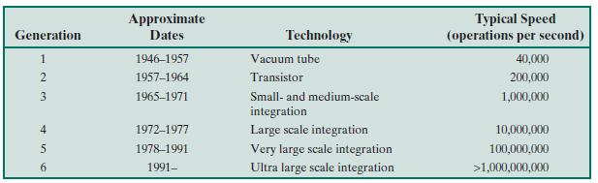
COMPUTER GENERATIONS

Slide 20
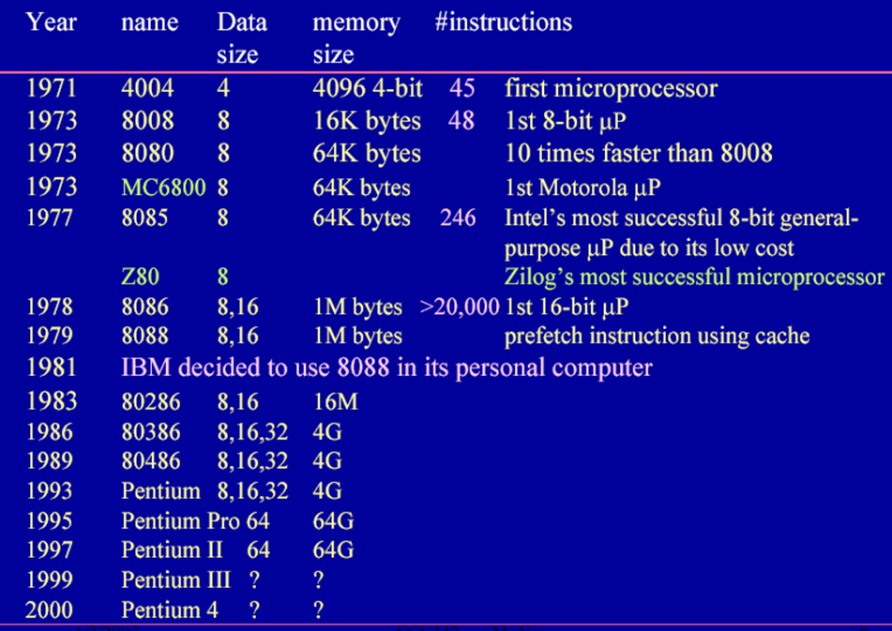

Slide 21
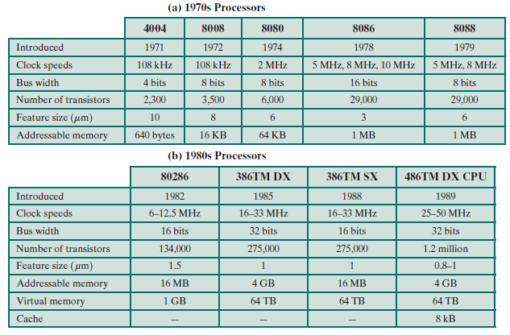
EVOLUTION OF INTEL MICROPROCESSORS

Slide 22
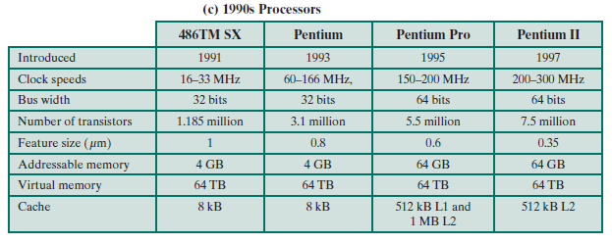
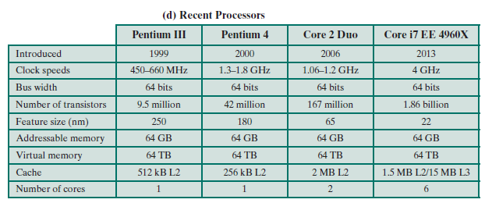
Contd.

Slide 23
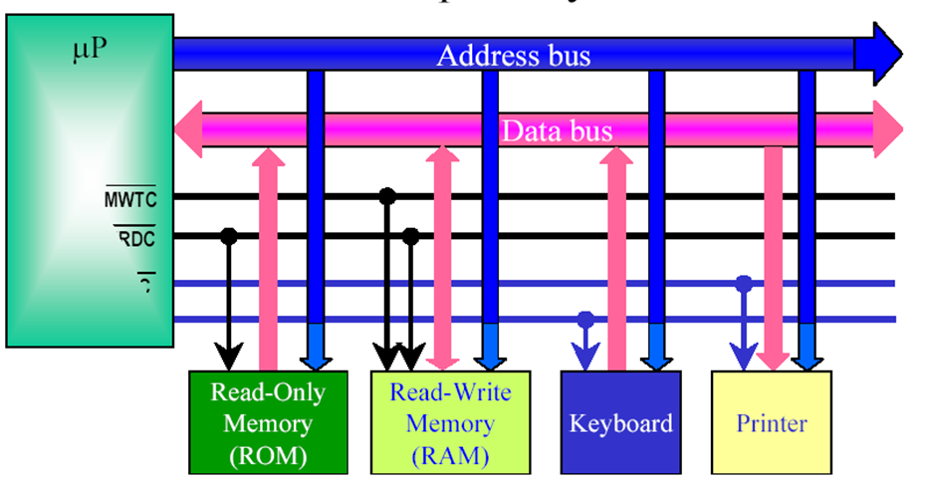
Block Diagram of a Microprocessor-based Computer system

Slide 24
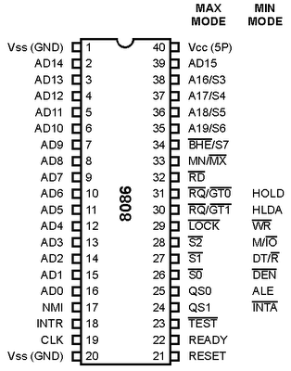
OVERVIEW OF 8086 MICROPROCESSOR
In April 1978, Intel introduced its first 16 bit microprocessor.
Production started in May, eventually the 8086 was officially released on June 8.
Fig. : Architecture diagram of 8086 Microprocessor IC.

Slide 25
FEATURES OF 8086
The most prominent features of a 8086 microprocessor are as follows:
It is a 40 pin dual in line package IC.
It is a 16-bit microprocessor.
8086 has a 20-bit address bus and can access up to 2^20 (1 MB) memory locations.
It can support up to 64K I/O ports.
It provides 14, 16-bit registers.
Word size is 16 bits and double word size is 4 bytes.
It has multiplexed address and data bus AD0-AD15 and A16-A19.

Slide 26
Contd.
It requires +5V power supply.
It can pre-fetch up to 6 instruction bytes from memory and queues them in order to speed up instruction execution.
It has multiplexed address and data bus AD0-AD15 and A16-A19.
It requires single phase clock with 33% duty cycle to provide internal timing.
Address ranges from 00000H to FFFFFH.
Memory is byte addressable – every byte has a separate address.
8086 is designed to operate in two modes: Minimum and Maximum.

Slide 27
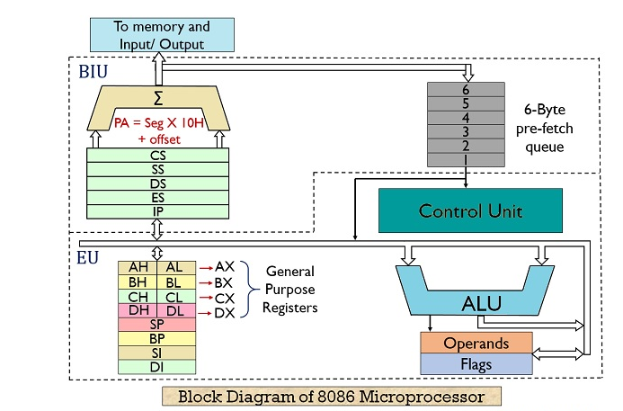

Slide 28
8086 has two blocks: BIU and EU.
The BIU handles all transactions of data and address on the buses for EU.
The BIU performs all bus operations such as instruction fetching, reading and writing operands for memory and calculating the addresses of the memory operands. The instruction bytes are transferred to the instruction queue.
EU executes instructions from the instruction system byte queue.
BIU contains Instruction queue, Segment registers, Instruction pointer and Address adder.
EU contains Control circuitry, Instruction decoder, ALU, Pointer and index register and Flag register.

Slide 29
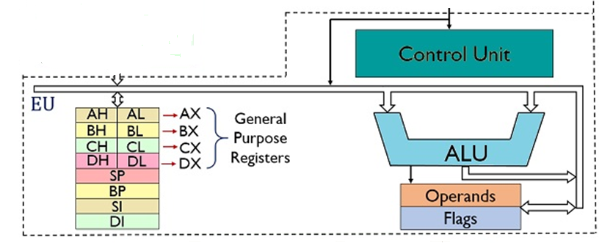
EU (Execution Unit)
Decodes instructions fetched by the BIU.
Generates control signals.
Executes instructions.
Main components are:
Instruction Decoder
Control System
Arithmetic Logic unit
General Purpose Registers
Flag Register
Pointer and Index Registers

Slide 30
INSTRUCTION DECODER
Translates instructions fetched from memory into a series of actions which EU carries out.
CONTROL SYSTEM
Generates timing and control signals to perform the internal operations of the microprocessor.
ARITHMETIC LOGIC UNIT
EU has a 16-biti ALU which can ADD, SUB, AND, OR, increment, decrement, complement or shift binary numbers.

Slide 31
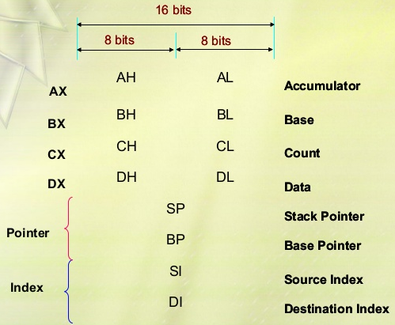

Slide 32
General Purpose Registers
EU has 8 general purpose registers.
Can be individually used for storing 8-bit data.
AL register is also called Accumulator.
Two registers can also be combined to form 16-bit registers.
The valid register pairs are – AX, BX, CX, DX.
AH | AL | AX
BH | BL | BX
CH | CL | CX
DH | DL | DX

Slide 33
GPR (contd.)
REGISTER | PURPOSE
AX | Word multiply, word divide, word I/O
AL | Byte multiply, byte divide, byte I/O, decimal arithmetic
AH | Byte multiply, byte divide
BX | Store address information
CX | String operation, loops
CL | Variable shift and rotate
DX | Word multiply, word divide, indirect I/O (used to hold I/O address during I/O instructions. If the result is more than 16-bits, the lower order 16-bits are stored in accumulator and higher order 6-bits are stored in DX register)

Slide 34
Flag Register
8086 has a 16-bit flag register.
A flag is a flip-flop which indicates some conditions produced by the execution of an instruction or controls certain operations of the EU.
Contains 9 active flags (out of 16 flags) and the remaining 7 are undefined.
There are two types of flags in 8086:
Conditional flags – six flags, set or reset by EU on the basis of results of some arithmetic operations or else also known as status flags as they indicates some conditions.
Control flags – three flags, used to control certain operations of the processor.

Slide 35
Flag Register (contd.)
U | U | U | U | OF | DF | IF | TF | SF | ZF | U | AF | U | PF | U | CF
U= unused
1. | CF | CARRY FLAG | CONDITIONAL FLAGS
2. | PF | PARITY FLAG
3. | AF | AUXILIARY FLAG
4. | ZF | ZERO FLAG
5. | SF | SIGN FLAG
6. | OF | OVERFLOW FLAG
7. | TF | TRAP FLAG | CONTROL FLAGS
8. | IF | INTERRUPT FLAG
9. | DF | DIRECTION FLAG

Slide 36
FLAG | PURPOSE
CF | Holds the carry after addition or the borrow after subtraction. Also indicates some error conditions as dictated by some programs and procedures.
PF | PF=0= odd parity ; PF=1=even parity
AF | Holds the carry (half carry) after addition or borrow after subtraction between bit positions 3 and 4 of the result (e.g. in BCD addition or subtraction)
ZF | Shows the result of the arithmetic or logic operation.
SF | Holds the sign of the result after an arithmetic/logic instruction execution.
TF | A control flag – it enables the trapping through an on-chip debugging feature.
IF | A control flag – controls the operation of the INTR (interrupt request). I=0=INTR pin disabled; I=1= INTR pin enabled.
DF | A control flag – it selects either the increment or decrement mode for DI and-or SI registers during the string instructions.
OF | Overflow occurs when signed numbers are added or subtracted. An overflow indicates the result has exceeded the capacity of the machine.

Slide 37
Pointer and Index Registers
Used to keep offset addresses.
Used in various forms of memory addressing.
In the case od SP and BP the default reference to form a physical address is the Stack segment (SS).
The index registers (SI and DI) and the BX generally default to the Data segment register (DS).
SP – stack pointer – used with SS to access the stack segment.
BP – base pointer – primarily used to access data on the stack and can be used to access data in other segments.

Slide 38
Pointer and Index Registers (contd.)
SI – Source index register – it is required for some string operations. When the string operations are performed, the SI register points to memory locations in the data segment which is addressed by the DS register. Thus SI is associated with the DS in string operations.
DI – destination index register – it is also required for some string operations. When string operations are performed, the DI register points to memory locations in the data segment which is addressed by the ES register. Thus, DI is associated with the ES in string operations.
The SI and DI registers may also be used to access data stored in arrays.

Slide 39
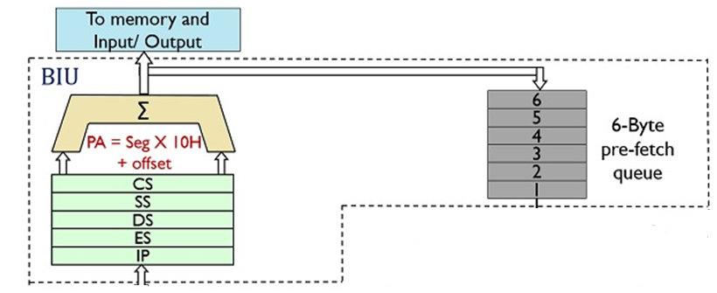
BIU (Bus Interface Unit)
Main components are :
6 bytes Instruction Queue (Q)
Segment Registers (CS, DS, ES, SS)
Instruction Pointer (IP)
The address summing block

Slide 40
Instruction Queue
8086 employs parallel processing.
The BIU uses a mechanism known as an instruction stream queue to implement a pipeline architecture.
When EU is busy decoding or executing current instruction, the buses of 8086 may not be in use.
At that time, BIU can use buses to fetch up to six instruction bytes for the following instructions.
BIU stores these pre-fetched bytes in a FIFO register called Instruction Queue.
When EU is ready for its next instruction, it simply reads the instruction from the queue in BIU.

Slide 41
Pipelining
EU of 8086 does not have to wait in between for BIU to fetch next instruction byte from memory.
So the presence of a queue in 8086 speeds up the processing.
Fetching the next instruction while the current instruction executes is called pipelining.

Slide 42
Memory Segmentation
8086 has a 20-bit address bus.
So it can address a maximum of 1MB of memory.
8086 can work with only four 64KB segments at a time within this 1MB range.
These four memory segments are called:
(i) CODE segment
(ii) STACK segment
(iii) DATA segment
(iv) EXTRA segment

Slide 43
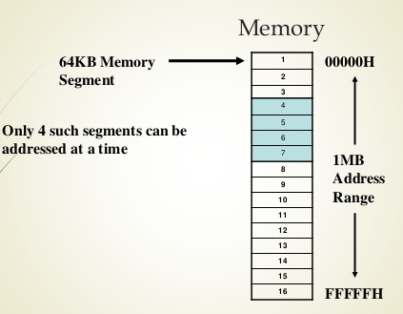

Slide 44
CODE SEGMENT
The part of memory from where BIU is currently fetching instruction code bytes. It is used for storing the instructions.
STACK SEGMENT
A section of memory set aside to store address and data while a subprogram executes. It is sued as a stack and is used to store the return address.
DATA AND EXTRA SEGMENTS
Used for storing data values or data bytes to be used in the program.

Slide 45
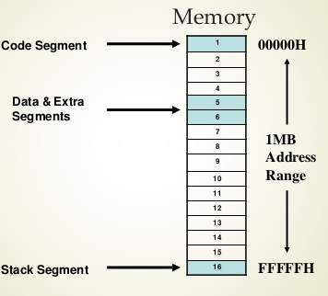

Slide 46
Segment Registers
It holds the upper 16-bits of the starting address for each of the segments.
The four segment registers are:
(i) CS - CODE segment register
(ii) SS - STACK segment register
(iii) DS - DATA segment register
(iv) ES - EXTRA segment register
The size of each segment is 64 KB.
A segment may be located any-where in the memory.
Each of these segments can be used for a specific function.

Slide 47
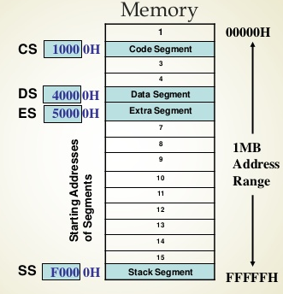

Slide 48
Segment Registers (contd.)
Address of a segment is of 20-bits.
A segment register stores only upper 16 bits of the starting address of the corresponding segments.
The 1-bit contents of the segment registers in the BIU actually points to the starting location of a particular segment.
BIU always inserts zeros for the lowest 4-bits of the 20-bit starting address.
E.g. if CS = 348AH, then the code segment will start at 348A0H.
A 64-KB segment can be located anywhere in the memory, bus will start at an address with zero in the lowest 4-bits.
Segments may be overlapped or non-overlapped.

Slide 49
IP (Instruction Pointer) Register
It is a 16-bit register.
Holds 16-bit offset, of the next instruction byte in the code segment.
BIU uses IP and CS registers to generate the 20-bit address of the instruction to be fetched from memory.

Slide 50
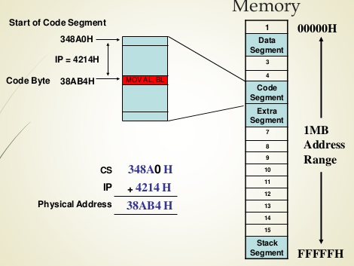

Slide 51
SS (Stack Segment) Register and SP (Stack Pointer) Register
Upper 16-bits of the starting address of stack segment is stored in SS register.
It is located in BIU.
SP register holds a 16-bit offset from the start of stack segment to the top of the stack.
It is located in EU.

Slide 52
Other Pointer and Index Registers
Base Pointer (BP) register
Source index (SI) register
Destination Index (DI) register
Can be used for temporary storage of data.
Main use is to hold a 16-bit offset of a data word in one of the segments.

Slide 53
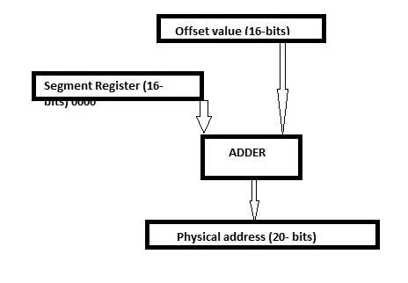
Memory Address Generation

Slide 54
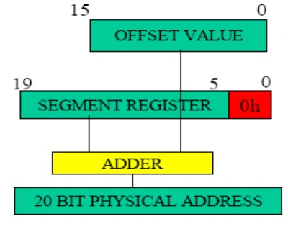
Example

Slide 55
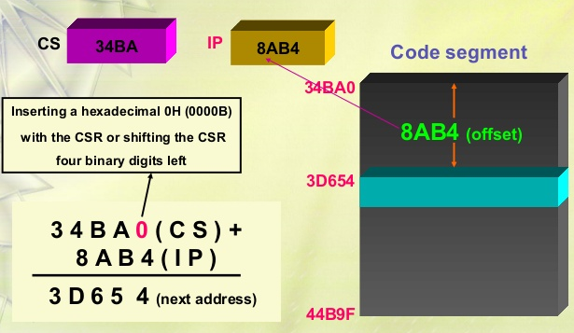
Example showing the CS:IP scheme of address formation

Slide 56
Segment and Address Register Combination
CS:IP
SS:SP – SS:BP
DS:BX – DS:SI
DS:DI (for other than string operations)
ES:DI (for string operations)

Slide 57
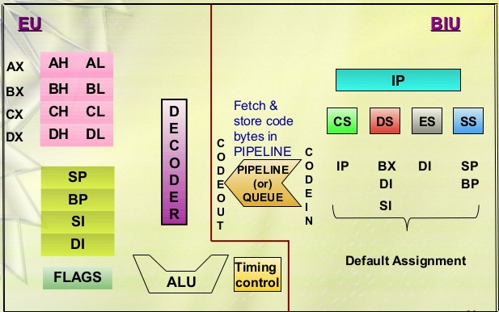
Summary of Registers and Pipeline of 8086 Microprocessor

Slide 58
Instruction Set
8086 supports 6 types of instructions-
1. Data Transfer Instructions
Mnemonics: MOV, XCHG, PUSH, POP, IN, OUT
2. Arithmetic Instructions
Mnemonics: ADD, ADC, SUB, SBB, INC, DEC,MUL,DIV,CMP
3. Logical Instructions
Mnemonics: AND, OR, XOR, TEST, SHR, SHL, RCR, RCL

Slide 59
Instruction Set
4. String Manipulation Instructions
Mnemonics: REP, MOVS, CMPS,SCAS,LODS, STOS
5. Processor Control Instructions
Mnemonics: STC, CMC, STD, CLD, STI,CLI, NOP, HLT, ESC, LOCK
6. Control Transfer Instructions
Mnemonics: CALL, RET, JMP

Slide 60
ADDRESSING MODES
The different ways in which a source operand is denoted in an instruction is known as addressing modes.
There are 8 different addressing modes in 8086 programming.
Immediate addressing mode
Register addressing mode
Direct addressing mode
Register indirect addressing mode
Based addressing mode
Indexed addressing mode
Base-index addressing mode
Base-indexed with displacement mode

Slide 61
Addressing Modes (Contd.)
Immediate addressing mode: The addressing mode in which the data operand is a part of the instruction itself is known as immediate addressing mode.
Register addressing mode : It means that the register is the source of an operand for an instruction.
Direct addressing mode : the addressing mode in which the effective address of the memory location is written directly in the instruction..
Register indirect addressing mode : this addressing mode allows data to be addressed at any memory location through an offset address held in any of following registers : BP, BX, DI and SI.

Slide 62
Addressing Modes (Contd.)
Base addressing mode : In this addressing mode, the offset address of the operand is given by the sum of the contents of the BX/BP registers and 8-bit/16-bit displacement.
Indexed addressing mode : In this addressing mode, the operands offset address is found by adding the contents of SI or DI register and 8-bit/16-bit displacements.
Base-index addressing mode : In this addressing mode, the offset address of the operand is computed by summing the base register to the contents of an Index register.
Base indexed with displacement addressing mode : In this addressing mode, the operands offset is computed by adding the base register contents. An index register contains an 8-bit or 16-bit displacement.

Slide 63
APPLICATIONS OF 8086
Gaming devices.
Mobile phones, laptops and electronic gadgets.
Traffic light controllers
Home appliances like washing machines and microwave ovens.
Frequency counters and synthesizers.
Digital clocks.

Slide 64
THANK YOU

